Slide 1
Shashwatha.S
3/21/2024 Annual Review

Slide 2
Keylogger and Security
3/21/2024 Annual Review

Slide 3


Keylogger
* What is keylogger ?
*What are the types in keylogger we have ?
* What are the uses of keylogger ?
-> Keylogger : A keylogger , sometimes called a keystroke logger , is a type of surveillance technology
used to monitor and record each keystroke on a specific device , such as a computer or smartphone.
It can be either hardware - or software -based .
Ttyun ,The latter type is also known as system monitoring software or keyboard capture software.
- - - - -> Types : There are two types
1. Hardware-based keylogger
2. Software-based keylogger
-> Uses: keylogger are often used as a spyware tool by cybercriminals to steal personally
identifiable information ,login credentials and sensitive enterprise data.
3/21/2024 Annual Review

Slide 4

PROBLEM STATEMENT

Slide 5

PROJECT OVERVIEW
Imagine delving into the realm of cybersecurity by crafting a cutting-edge Python keylogger enriched with a sleek graphical interface using `tkinter`. This project embarks on a journey to blend the art of key press monitoring with the science of user-friendly design, culminating in a dynamic tool that captures keystrokes with precision and presents them in a visually engaging format.
By harmonizing technical prowess with aesthetic appeal, this endeavor not only enhances data logging efficiency but also elevates the user experience, offering a novel perspective on the intersection of functionality and style in software development.
3/21/2024 Annual Review

Slide 6

WHO ARE THE END USERS?
The end users of this project could include cybersecurity professionals, software developers, ethical hackers, and individuals seeking to monitor and log keystrokes for security or productivity purposes.
Additionally, students or researchers interested in cybersecurity concepts and Python programming may also find this project beneficial for learning and experimentation. The user-friendly GUI aspect could attract individuals who prefer a visually appealing and intuitive interface for interacting with the keylogging tool.
3/21/2024 Annual Review

Slide 7

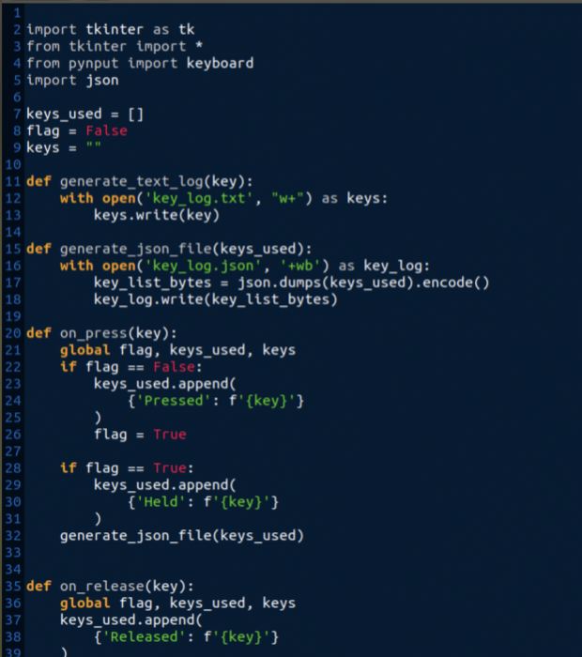
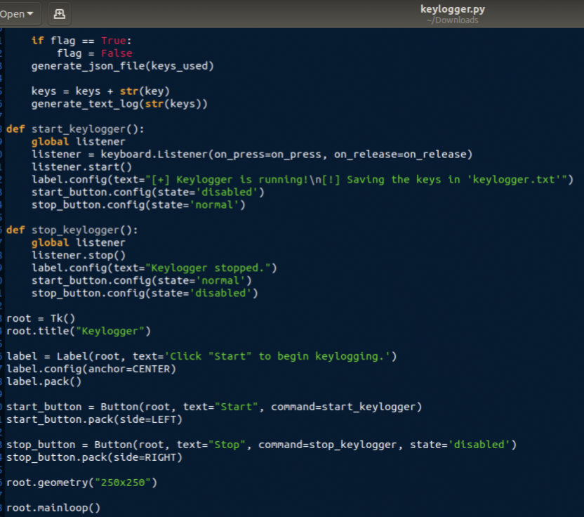
YOUR SOLUTION AND ITS VALUE PROPOSITION
Developing a slotion for keylogger using pyinput and jsonlib
3/21/2024 Annual Review

Slide 8

THE WOW IN YOUR SOLUTION
The wow factor in Python keylogger project solution lies in the seamless integration of advanced keylogging functionality with a visually appealing GUI interface. By combining the technical sophistication of key press monitoring with the user-friendly design of `tkinter`, not only excels in data capture accuracy but also enhances the overall user experience.
This harmonious blend of powerful functionality and elegant presentation sets your keylogger solution apart, offering a compelling and innovative approach to keystroke logging in the realm of cybersecurity and software development.
3/21/2024 Annual Review
8

Slide 9
MODELLING
Keylogger Module : This module will handle the keylogging functionality using the `pynput` library to monitor and record keystrokes.
GUI Module : The GUI module will be responsible for creating the graphical user interface using `tkinter` to provide a visually appealing way for users to interact with the keylogger.
Pynput : `pynput` is a Python library that enables you to control and monitor input devices such as the mouse and keyboard.
jsonlib : The standard library for working with JSON data in Python is called `json`. It provides functions for encoding Python objects into JSON strings and decoding JSON strings into Python objects.
9

Slide 10
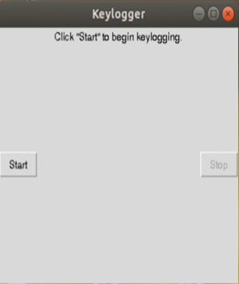
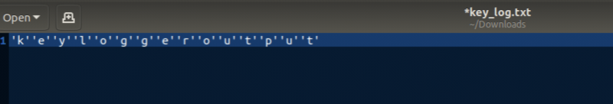
RESULTS
Coupled with a sophisticated GUI, harmonizes advanced keylogging functionalities with an appealing user interface. This integration seamlessly captures keystrokes while presenting a visually engaging user experience.
The provided solution gives the following output :
After executing key_log.txt text fikr is created.It consists the following :
3/21/2024 Annual Review
10

